Slide 1

Mindscape: an AI-powered study companion integrating NLP algorithms
Group members
Project Guide
Prof. Sheetal Jadhav
Moodle Id | Student Name
21107019 | Riya Rajesh Sawant
21107012 | Rutuja Patil
21107006 | Tanvi Panchal
22207008 | Sneha Sabat

Slide 2
Outline
Introduction
Literature Survey of the existing systems
Limitations of the existing systems
Problem statement
System Design
Technologies and methodologies
Implementation
Conclusion
References

Slide 3
Introduction
The traditional educational methods, relying on standard textbooks, classroom settings, and limited personalized assistance, present several impediments. The absence of a personalized approach to learning often results in inefficiencies, demotivation, and a failure to achieve educational objectives.
Our project aims to integrate technologies like NLP, speech recognition, tokenization, transcription, MCQ generation, and flashcard generation into educational practices which will empower students with accessible, personalized, and interactive learning experiences, ultimately contributing to improved performance, comprehension, and academic success.
1.1 Motivation
Taking on an NLP-based project to aid students in their studies leverages advanced technology to streamline learning processes. Creating tools using NLP makes learning easier for students by summarizing, transcribing, and personalizing study materials, ultimately making education more accessible and adaptable.

Slide 4
1.2 Objectives
To provide real-time transcription of lectures and study sessions to assist users in capturing key points and insights using Automatic Speech Recognition (ASR) algorithms.
To enable users to create comprehensive and detailed notes during study sessions using Natural Language Processing (NLP) algorithms for text analysis.
To generate concise summaries of study materials for quick review and understanding using Text summarization libraries like PyMuPDF and YoutubetranscriptAPI.
To automatically generate multiple-choice questions based on study materials to assess users' understanding using NLP’s Python keyword extraction (PKE) technique.
To create interactive flashcards from study materials to aid in memorization and revision similar to summarized notes, utilizing NLP libraries such as PyPDF2 for pdf processing and spacy for NLP tasks.
To allow users to customize study materials according to their preferences and learning objectives.
To enable users to export or share their generated study materials for collaboration or offline use with the help of File I/O libraries for exporting study materials in pdf formats.

Slide 5
Literature Survey of the existing system
Author | Year | Title | Methods Used | Merits
Jungwon Chang․Hosung Nam | 2023 | A case study on Whisper model and KsponSpeech dataset[1] | Automatic speech recognition, Transformers, Whisper | The Whisper model, developed by OpenAI, is trained through multitask learning using 680,000 hours of speech data prepared through weak supervision . The model is divided into tiny, base, small, medium, and large sizes, with the large model being further improved by changes in training techniques and the subsequent release of the “large-v2” model
KhushiPorwal , Harshit Srivastava, Ritik Gupta , Shivesh Pratap , Nidhi Gupta | 2022 | Video Transcription and Summarization using NLP[2] | Transcription, Text summarization, Natural Language Processing | Propose an algorithm to automatically summarize video programs and used concepts from text summarization, applied to transcripts derived using automatic speech recognition

Slide 6
Literature Survey of the existing system
Author | Year | Title | Methods Used | Merits
Wafaa S. El-Kassas, Cherif R. Salama, Ahmed A. Rafea, Hoda K. Mohamed | 2021 | Automatic text summarization: A comprehensive survey[3] | Sentences segmentation, Words tokenization, Removal of stop-words, Part-of-speech tagging, Stemming | There are three main text summarization approaches: extractive, abstractive, or hybrid. Using one of the text summarization approaches reordering the selected sentences before generating the final summary.
Virender Dehru, Pradeep Kumar Tiwari , Gaurav Aggarwal , Bhavya Joshi and Pawan Kartik | 2020 | Text Summarization Techniques and Applications[4] | Term frequency - Inverse frequency text (tf-idf), TextRank | Calculates the score for the specified word based on either word probability or word frequency method and Tokenizes the paragraph based on the delimiter.

Slide 7
Limitations of existing systems
Lack of Personalized Educational Guidance and Support: Many individuals pursue their academic endeavors without access to personalized guidance and support, leading to a range of critical issues.
Ineffective Learning Strategies: Generic educational materials often fall short in addressing individual learning styles and objectives, resulting in inefficient study habits and a lack of comprehension
Difficulty in Achieving Educational Goals: Attaining academic milestones becomes challenging when learners lack proper monitoring, guidance, and customized learning approaches.
Risk of Learning Gaps: The reliance on one-size-fits-all resources may contribute to learning gaps, where individuals miss crucial concepts or fail to grasp fundamental principles.
Impact on Overall Academic Performance: Insufficient personalized educational support may have adverse effects on overall academic performance, potentially contributing to educational disparities and hindered intellectual development.

Slide 8
Problem statement
Problem Statement :
The challenge during lectures arises from the necessity for students to concurrently engage in two cognitive tasks: active listening to the instructor's spoken content and transcribing key points into written notes. This dual-task demand imposes cognitive load, dividing attention and potentially causing students to miss important concepts.
Students are limited by the resources available in their immediate vicinity, and quality educational support can be financially burdensome. The absence of a personalized approach to learning often results in inefficiencies, demotivation, and a failure to achieve educational objectives.
Solution Proposed :
Imagine a study companion that goes beyond traditional learning platforms, one that adapts to unique learning styles, preferences, and academic goals. The system offers real-time transcription, generating detailed notes converted to concise summaries for efficient review. It further enhances learning through MCQ tests and flashcards, supporting customization and multimedia integration. Users can export and share study materials, benefiting from organized content for streamlined education.

Slide 9
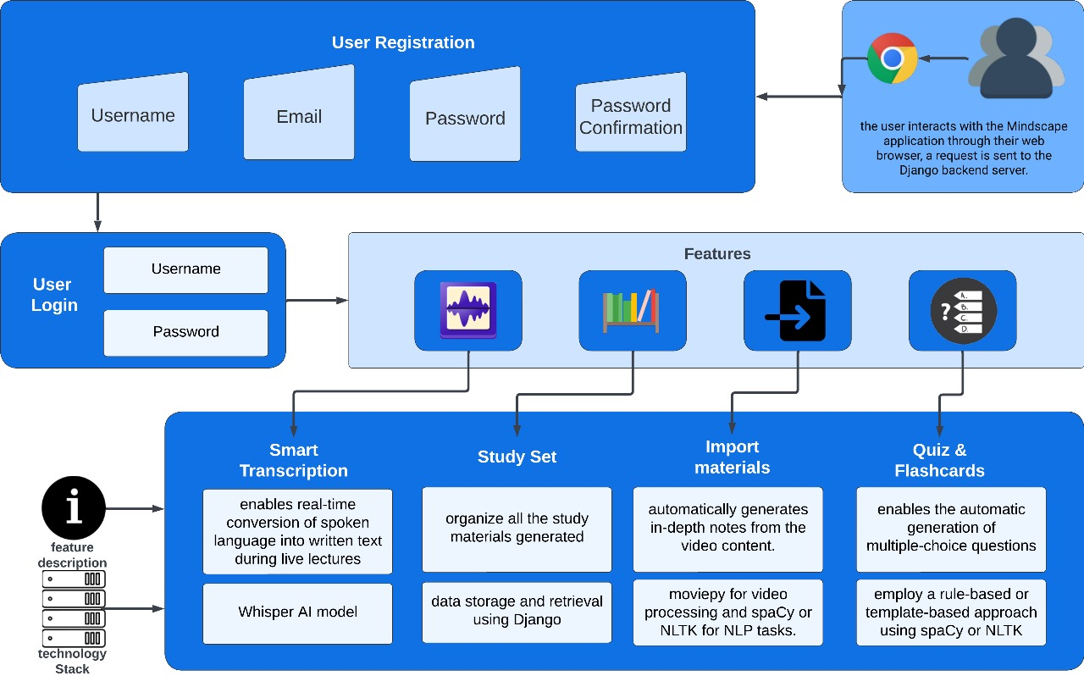
System Design

Slide 10
Technologies and methodologies
Frameworks/Technologies
  Python 3.11.4
  Django Framework 5.0.3
  SQLite 3.42.0
  Torch 2.2.1
  Transformers 4.38.2
Models
  Whisper – medium level
Algorithms used:
  Automatic Speech Recognition

Slide 11
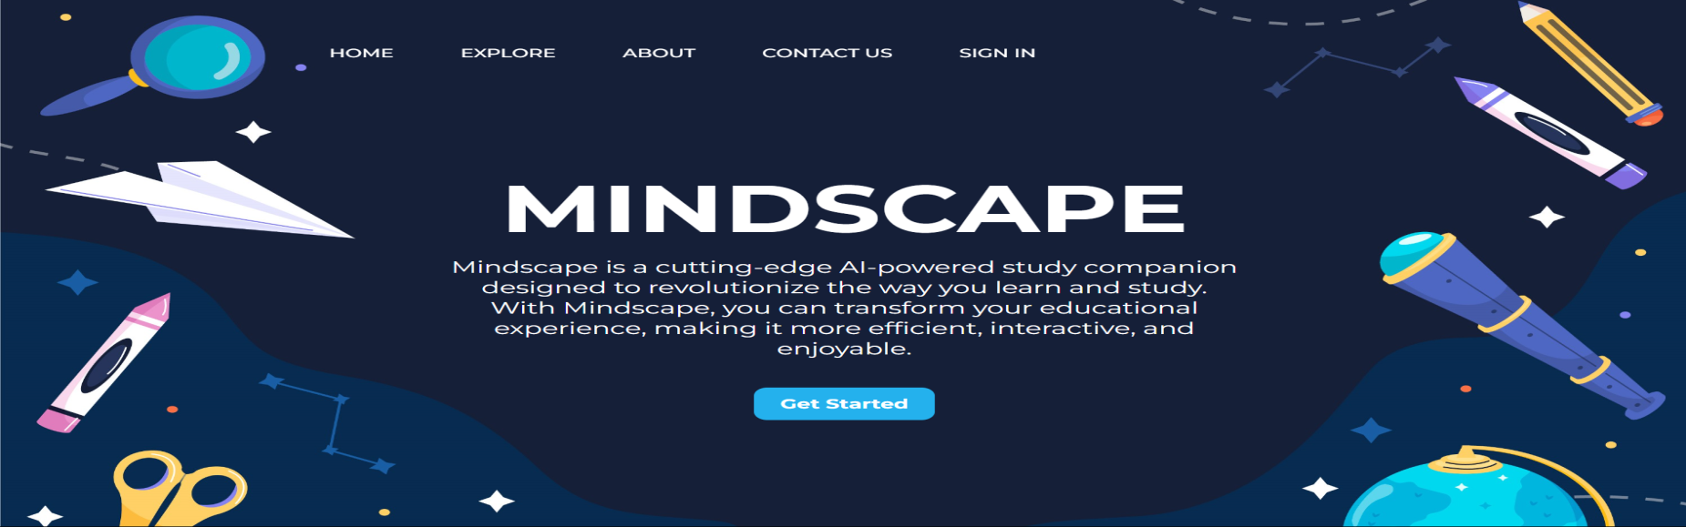
Implementation

Slide 12
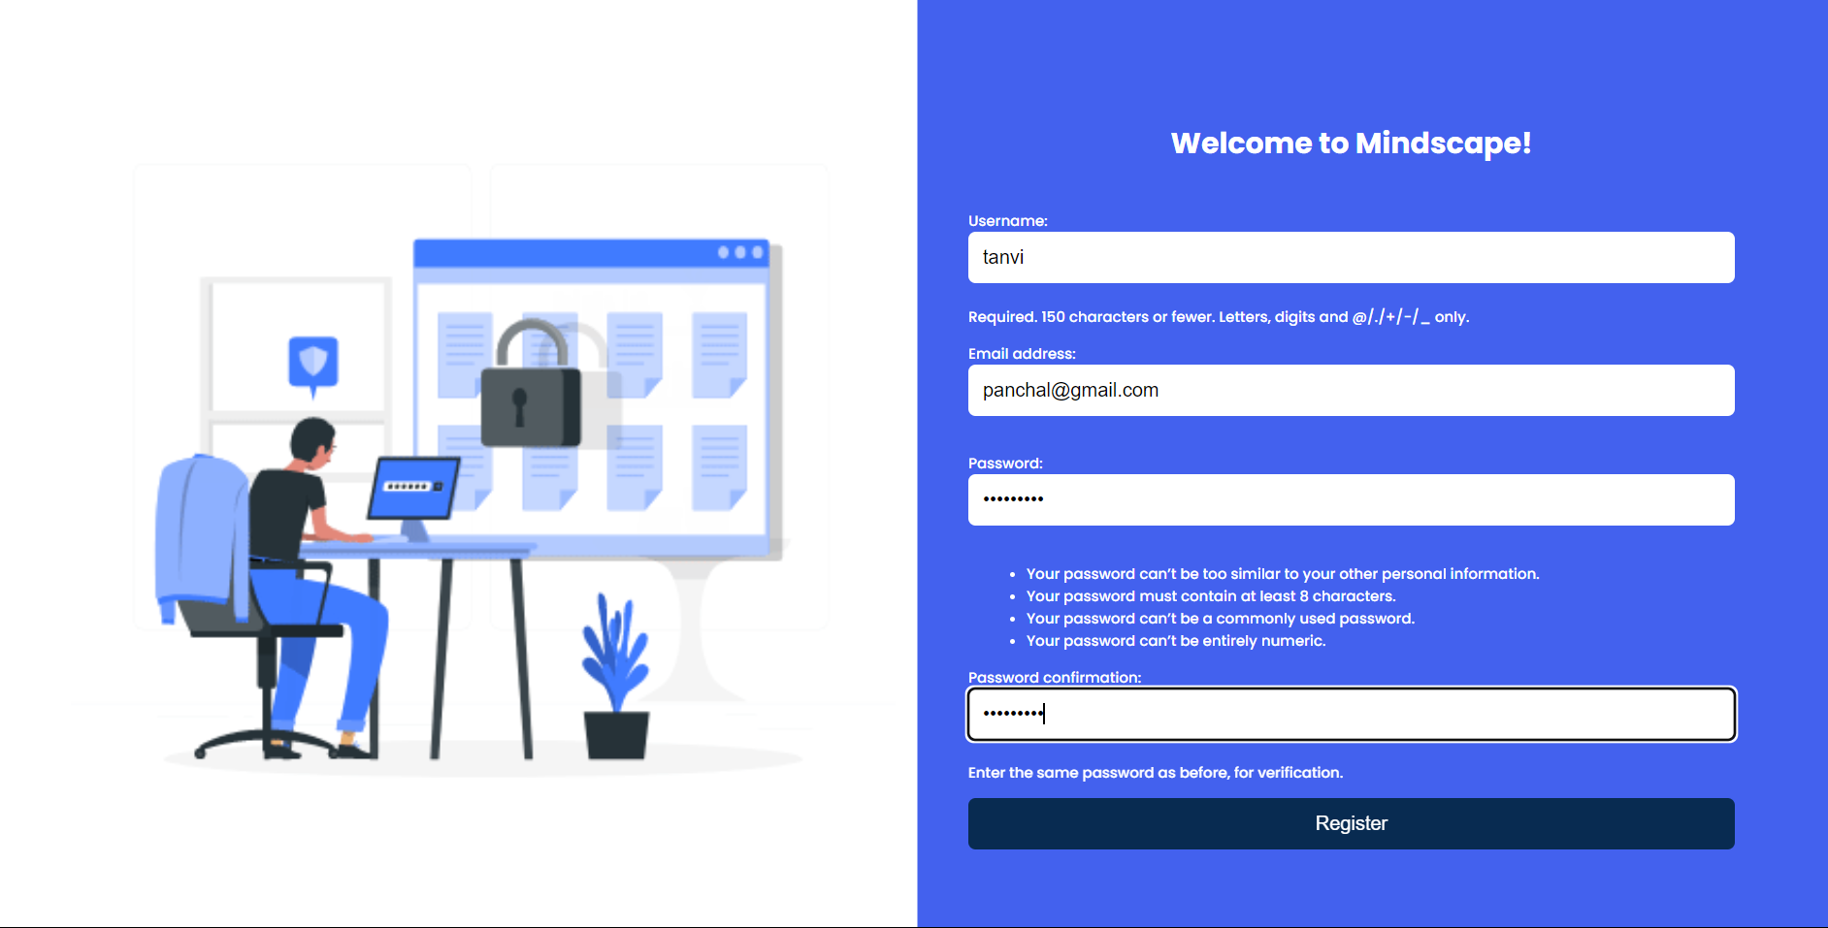

Slide 13
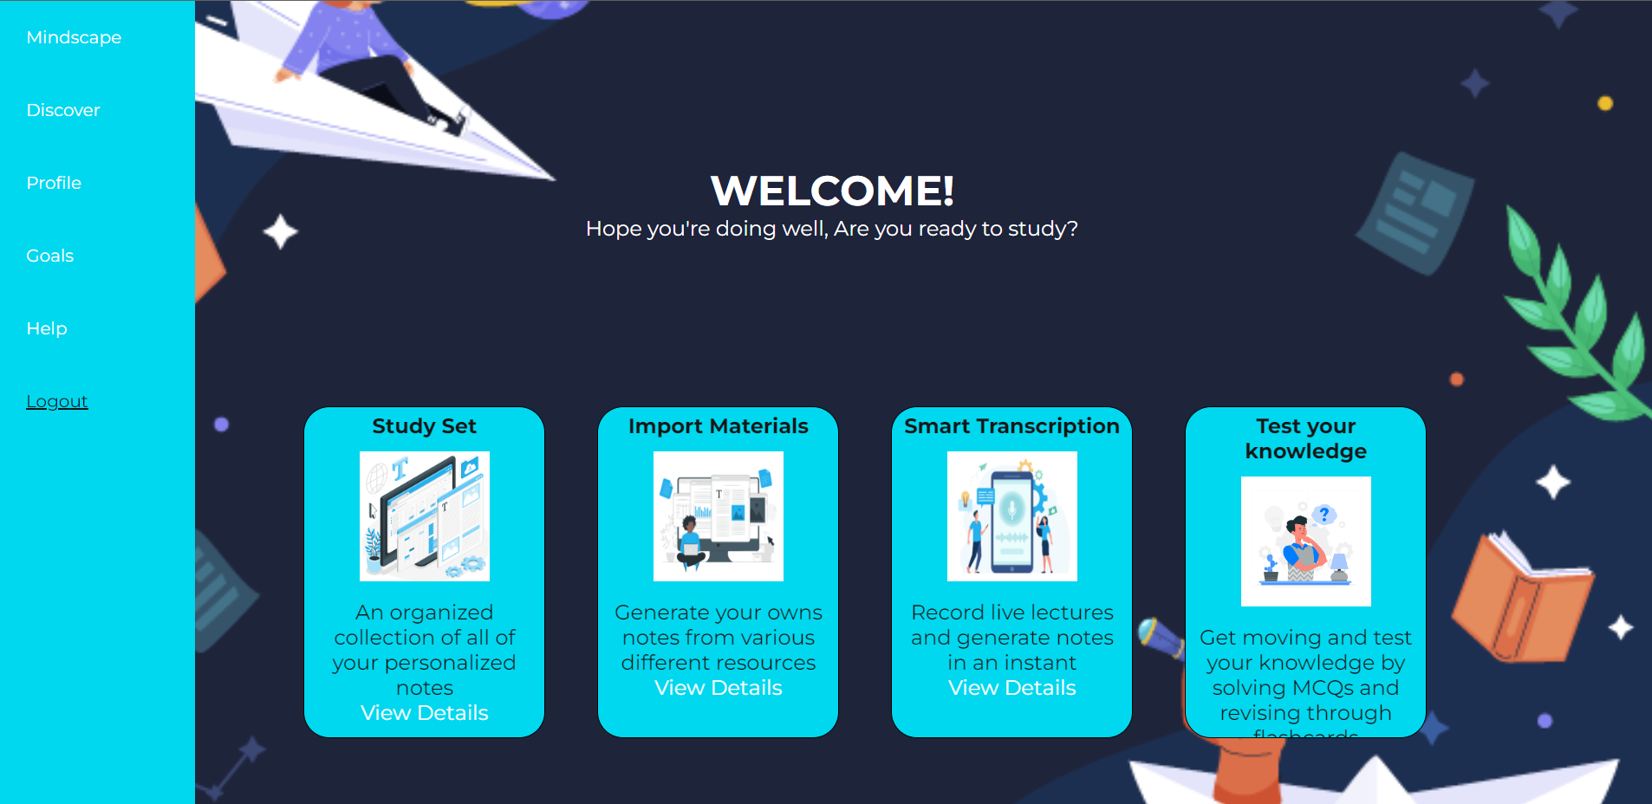

Slide 14
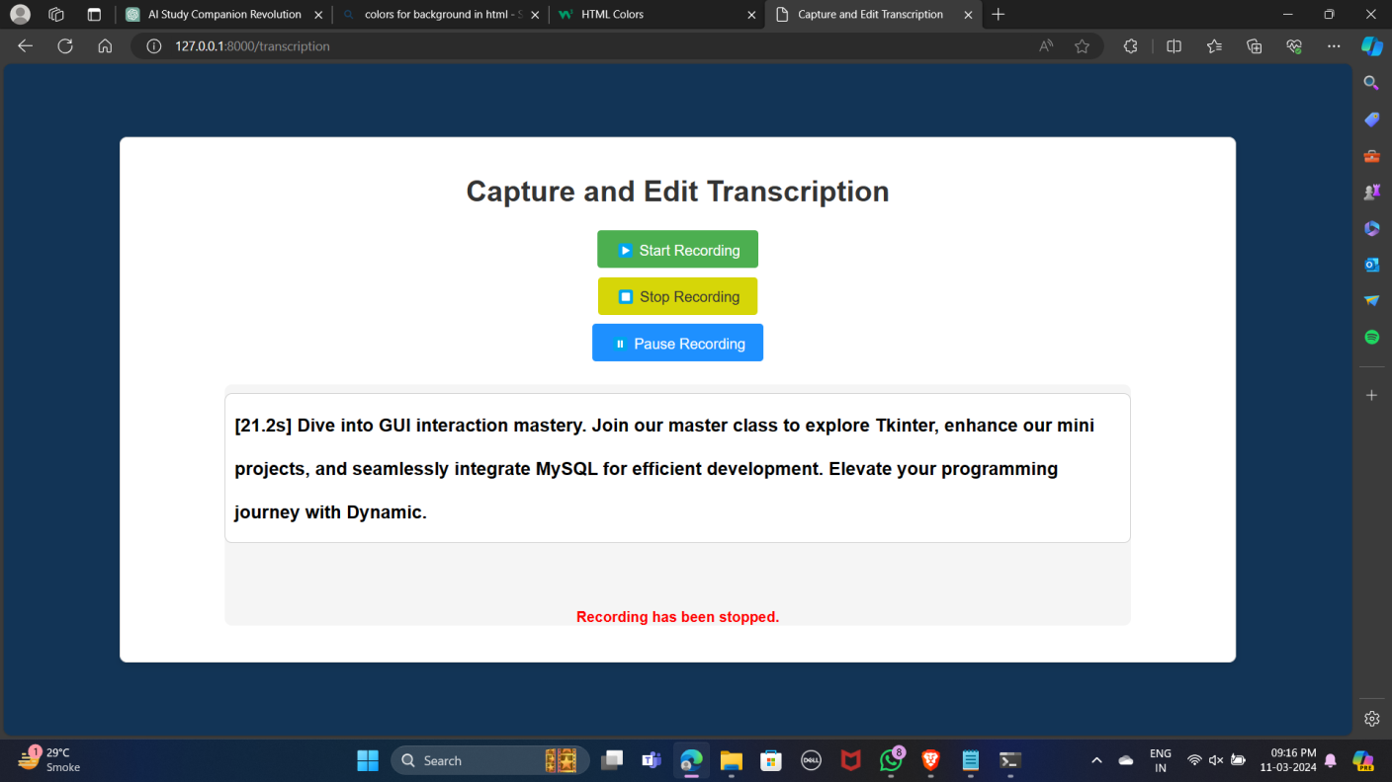

Slide 15
Conclusion
NLP and speech recognition technologies enable the creation of accessible learning materials by providing transcriptions of lectures and converting spoken content into text, catering to diverse learning styles and abilities. Transcription tools alleviate the cognitive burden of note-taking during lectures, allowing students to focus more on understanding concepts and engaging with the material rather than on capturing every detail in real-time. Interactive study materials, such as MCQs and flashcards, foster active engagement with the course material, promoting deeper comprehension and retention of key concepts through repeated exposure and self-assessment.
Integrating NLP, speech recognition, tokenization, transcription, MCQ generation, and flashcard generation technologies into educational practices empowers students with accessible, personalized, and interactive learning experiences, ultimately contributing to improved performance, comprehension, and academic success.

Slide 16
References
Jungwon Chang․Hosung Nam. “A case study on Whisper model and KsponSpeech dataset.”_Phonetics and Speech Sciences Vol.15 No.3 (2023) 83-88
Khushi Porwal , Harshit Srivastava, Ritik Gupta , Shivesh Pratap , Nidhi Gupta. “Video Transcription and Summarization using NLP.”_2nd International Conference on “Advancement in Electronics & Communication Engineering (AECE 2022) July 14-15, 2022
Wafaa S. El-Kassas, Cherif R. Salama, Ahmed A. Rafea, Hoda K. Mohamed. “Automatic text summarization: A comprehensive survey.” _Expert Systems with Applications Volume 165, 1 March 2021, 113679
Virender Dehru, Pradeep Kumar Tiwari , Gaurav Aggarwal , Bhavya Joshi and Pawan Kartik. “Text Summarization Techniques and Applications.”_IOP Conf. Series: Materials Science and Engineering 1099 (2021) 012042

Slide 17
Thank You...!!

